Slide 1
Quiz Logistics
Quiz time: 2:00-2:20pm
In Class:
1:50pm arrive, check-in with your USC ID
Online:
1:55pm join WebEx on DEN using your phone and
turn on your camera as instructed
2:00pm, use your laptop and go to DEN,
myTool->Quizzes, enter lockdown browser
type in password

Slide 2
Map-Reduce (Part II)
Professor Wei-Min Shen
University of Southern California
Thanks for source slides and material to: J. Leskovec, A. Rajaraman, J. Ullman: Mining of Massive Datasets (http://www.mmds.org)
Notes:
In last few years, map reduce has been widely used for mining really massive data sets.
Why we need Map reduce for processing the large data sets?
Start with basics

Slide 3
OUTLINE
Map-Reducer (Part II)
Spark and Scala (Introduction)
Quizzes and Homeworks

Slide 4
Map-Reduce: Overview
Map （dividing）
Divide a big job into many smaller local jobs
For each local job, extract an output pairs (key, values)
Group by key （gathering）
Sort, shuffle, group by keys
Reduce （harvesting）
Aggregate, summarize, filter or transform
Output the final result
Notes:
It groups all the same keys together.

Slide 5
Map-Reduce: The Map Step
Input: key-value pairs
k
v
k
v
JOB
…
k
v
Notes:
Here is another way of looking at it.
Start with a bunch of key value pairs.

Slide 6
Map-Reduce: The Map Step
Intermediate key-value pairs
Input: key-value pairs
k
v
map
k
v
k
v
k
v
…
k
v
Notes:
The map step takes the key-value pairs and maps them to intermediate key-value pairs.
For example, you run the map for the first key value pair (k, v) and it actually outputs two intermediate key value pairs.
the key in the intermediate key value pairs do not need to have the same key as the input. They could be different keys and they could be multiple of them.
They values could be different as well.
Notice, there could be zero, one or multiple key-value pairs for each key value pairs.

Slide 7
Map-Reduce: The Map Step
Intermediate key-value pairs
Input: key-value pairs
k
v
k
v
k
v
map
k
v
k
v
…
k
v

Slide 8
Map-Reduce: The Map Step
Intermediate key-value pairs
Input: key-value pairs
k
v
k
v
k
v
k
v
k
v
…
…
map
k
v
k
v
Notes:
So we go through the input file, apply the map function on each input record, and create the intermediate key-value pairs.

Slide 9
Map-Reduce: The Reduce Step
Shuffle/Group by Key Step
Intermediate key-value pairs
Key-value groups
Input: key-value pairs
k
v
k
v
v
v
k
v
k
v
k
v
v
k
v
k
v
Group by key
…
…
…
k
v
k
v
k
v
Notes:
So we go through the input file, apply the map function on each input record, and create the intermediate key-value pairs.

Slide 10
Map-Reduce: The Reduce Step
Shuffle/Group by Key Step
Intermediate key-value pairs
Key-value groups
k
v
k
v
v
v
k
v
Group by key
k
v
v
k
v
…
…
k
v
k
v
Notes:
Now the next step, is to take the intermediate key-value pairs and group them by key.
All the intermediate key-value pairs that have the same key will be grouped together.
So it turns out, there are three values with the first key, two values with the second key.
And these are all different values, although I use the same color here.

Slide 11
Map-Reduce: The Reduce Step
Shuffle/Group by Key Step
Intermediate key-value pairs
Key-value groups
Output key-value pairs
reduce
k
v
k
v
v
v
k
v
k
v
Group by key
k
v
v
k
v
…
…
k
v
k
v
Notes:
The reducer takes look at a single key-value group as input and produces the output that has the same key.
But it combines the values for a given key into a single value. For example, it could add up all the values. Or it could multiple them, Or it could compute the average of them
Or even more complicated computations base on your requirement.

Slide 12
Map-Reduce: The Reduce Step
Shuffle/Group by Key Step
Intermediate key-value pairs
Key-value groups
Output key-value pairs
reduce
k
v
k
v
v
v
k
v
reduce
k
v
Group by key
k
v
v
k
v
k
v
…
…
…
k
v
k
v
k
v
Notes:
And them the reducer looks at the second key-value group and output a single value for that key
and repeat this operation for all the key-value groups.

Slide 13
More Formally…
Input: a set of key-value pairs
Programmer need to specify two methods:
Map(k, v) → <k’, v’>*
Takes a key-value pair and outputs a set of key-value pairs
E.g., Input: (k,v): k is the filename, v is the file
Output: <k’,v’>*: k’ is the filename, v’ is a single line in the file
E.g., Input: (k,v): k is the filename, v is a single line in the file
Output: <k’,v’>*: k’ is a word, v’ is the count of that word
There is one Map call for every (k, v) pair
Reduce(k’, <v’>*) → <k’, v’’>*
All values v’ with same key k’ are reduced together
There is one Reduce function call per unique key k’
Notes:
The reducer takes a set of key value groups, the group consists of a key and a set of values for that key.
In the output, once again, the key is the same as the input key but the value is obtained by combining the input values in some manner.

Slide 14
Map-Reduce Examples (in Part I)
Word count: a huge file => (word, count)
Inverted Index: (ID, content)* => (content, List[IDs])
Count friends: Pair of friends (X, Y)* => (X, Nx), (Y, Ny), …
A huge file of integers => Unique integers divisible by 7
Challenges: What should the Map do? What should the Reduce do?
Criteria: the overall work and traffic must be as efficient as possible!
the speed is the ultimate judger!
Notes:
Map task produces (integer, 1) of the largest value in that chunk as key, value pair
Grouping by key just identifies duplicates
Single reduce task: produces (integer, integer) of largest value
What about multiple reduce tasks? Keys would be sorted, so only look at output from the Reduce stage that has the highest keys

Slide 15
Map-Reduce example B1
Find largest integer (Exercise 2.3.1 in book)
Design MapReduce algorithms to take a very large file of integers and produce the largest integer as output
The large file of integers cannot fit in the memory of node
Map task:
Each Map task gets a chunk of the file of integers and processes it …
Reduce task:
?
Notes:
Map task produces (integer, 1) of the largest value in that chunk as key, value pair
Grouping by key just identifies duplicates
Single reduce task: produces (integer, integer) of largest value
What about multiple reduce tasks? Keys would be sorted, so only look at output from the Reduce stage that has the highest keys

Slide 16

Map-Reduce example B1
Find largest integer (Exercise 2.3.1 in book)
Design MapReduce algorithms to take a very large file of integers and produce the largest integer as output
The large file of integers cannot fit in the memory of node
Map task:
Map task produces (1, largest-integer) of the largest value in the local chunk given as (key, value) pairs
(10, 1, 9, 3, 4, 5, 6, 7)
(1, 10)
(6, 7, 19, 43, 54, 25, 61, 17)
(1, 61)
MAP
(0, 15, 9, 43, 4, 15, 46, 7)
(1, 46)
Notes:
Map task produces (integer, 1) of the largest value in that chunk as key, value pair
Grouping by key just identifies duplicates
Single reduce task: produces (integer, integer) of largest value
What about multiple reduce tasks? Keys would be sorted, so only look at output from the Reduce stage that has the highest keys

Slide 17

Map-Reduce example B1
Find largest integer (Exercise 2.3.1 in book)
Design MapReduce algorithms to take a very large file of integers and produce the largest integer as output
The large file of integers cannot fit in the memory of node
Group by key:
(1, 10)
(1, 61)
GROUP BY KEY
(1, (10, 61, 46))
(1, 46)
Notes:
Map task produces (integer, 1) of the largest value in that chunk as key, value pair
Grouping by key just identifies duplicates
Single reduce task: produces (integer, integer) of largest value
What about multiple reduce tasks? Keys would be sorted, so only look at output from the Reduce stage that has the highest keys

Slide 18

Map-Reduce example B1
Find largest integer (Exercise 2.3.1 in book)
Design MapReduce algorithms to take a very large file of integers and produce the largest integer as output
The large file of integers cannot fit in the memory of node
Reduce task:
Single Reduce task is needed to pick the largest integer
(1, (10, 61, 46))
REDUCE
(1, 61) => 61
Notes:
Map task produces (integer, 1) of the largest value in that chunk as key, value pair
Grouping by key just identifies duplicates
Single reduce task: produces (integer, integer) of largest value
What about multiple reduce tasks? Keys would be sorted, so only look at output from the Reduce stage that has the highest keys

Slide 19
Map-Reduce example B2
Get unique integers (Exercise 2.3.1 in book)
Design MapReduce algorithms to take a very large file of integers and produce a set of unique integers as output
The large file of integers cannot fit in the memory of node
Map task:
Each Map task gets a chunk of the file of integers and processes it …
Reduce task:
?
Notes:
Map task produces (integer, 1) of the largest value in that chunk as key, value pair
Grouping by key just identifies duplicates
Single reduce task: produces (integer, integer) of largest value
What about multiple reduce tasks? Keys would be sorted, so only look at output from the Reduce stage that has the highest keys

Slide 20
Map-Reduce example B2
Get unique integers (Exercise 2.3.1 in book)
Design MapReduce algorithms to take a very large file of integers and produce a set of unique integers as output
The large file of integers cannot fit in the memory of node
Map task:
Emit (integer, 1) once only for each unique integer for each chunk
e.g., maintain an array or a map to track whether have seen/emitted that integer before

Slide 21
Map-Reduce example B2
Get unique integers (Exercise 2.3.1 in book)
Design MapReduce algorithms to take a very large file of integers and produce a set of unique integers as output
The large file of integers cannot fit in the memory of node
Shuffle step:
Shuffle step will group together all values for the same integer: (integer, (1, 1, 1, 1, …))
Same integer might appear in multiple chunks from Map tasks and each integer key will only go to one Reduce task
Notes:
Map task produces (integer, 1) of the largest value in that chunk as key, value pair
Grouping by key just identifies duplicates
Single reduce task: produces (integer, integer) of largest value
What about multiple reduce tasks? Keys would be sorted, so only look at output from the Reduce stage that has the highest keys

Slide 22
Map-Reduce example B2
Get unique integers (Exercise 2.3.1 in book)
Design MapReduce algorithms to take a very large file of integers and produce a set of unique integers as output
The large file of integers cannot fit in the memory of node
Reduce task:
Each Reduce task eliminates duplicates (also ignore list of 1’s) for each integer key and emit (integer)
Combine the output from multiple reduce tasks (not required to be in any order)
Notes:
Map task produces (integer, 1) of the largest value in that chunk as key, value pair
Grouping by key just identifies duplicates
Single reduce task: produces (integer, integer) of largest value
What about multiple reduce tasks? Keys would be sorted, so only look at output from the Reduce stage that has the highest keys

Slide 23
Map-Reduce example B3
Count the number of unique integers (Exercise 2.3.1 in book)
Design MapReduce algorithms to take a very large file of integers and produce the count of the number of distinct integers as output
The large file of integers cannot fit in the memory of node
Map task:
Each Map task gets a chunk of the file of integers and processes it …
Reduce task:
?

Slide 24
Map-Reduce example B3
Count the number of unique integers (Exercise 2.3.1 in book)
Two stages needed
First phase: eliminate duplicates in large input file
Map task 1: just emit (integer, 1) for unique integers
e.g., Mapper 1 (chunk1, (7, 7, 8, 8, …)) => (7, 1), (8,1), …
Mapper 2 (chunk1, (7, 7, 9, …)) => (7, 1), (9,1), …
Reduce task 1: Eliminates duplicates (across chunks)
e.g., (7, (1, 1)) => (7, 1) or just 7
(8, (1)) => (8, 1) or just 8

Slide 25
Map-Reduce example B3
Count the number of unique integers (Exercise 2.3.1 in book)
Two stages needed
Second phase: count unique numbers
Map task 2: each map task gets some unique integers from the previous Reduce phase as the input and output the key-value pair like (some key, count) (e.g., let key be 1)
e.g., (7, 8, 9, 12, 13) => (1, 5)
Reduce task 2: A single Reducer, sums all counts from map tasks and produces overall count

Slide 26
Combiners: (“helpers” of map)
Often a Map task will produce many pairs of the form (k, v₁), (k, v₂), … for the same key k
e.g., popular words “the” would appear thousands of times in the word count example, generate thousands of (“the”, 1) tuples in each mapper, and ship to reducers
Instead of producing many pairs (“the”, 1), (“the”, 1), … can sum the n occurrences of “the” (each word) and emit (w, n) in Map task before shipping to reducers
Now each node only sends a single value for each word
Can save network time by pre-aggregating values in the mapper

Slide 27
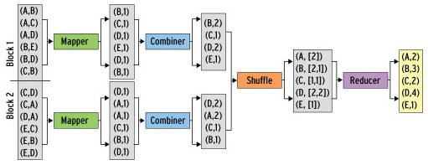
Refinement: Combiners
Combiner combines the values of all keys of a single mapper (single node)
Much less data needs to be copied and shuffled!

Slide 28
Combiners (“pre”-reducers)
Combiners run after the Mappers and before the Reducers
Combiner receives all data emitted by the Mapper as input
The output of the Combiners is then sent to the Reducers
Usage of the Combiner is optional (When to use ?)
Located at map: If combiner is suitable for the job, the instances of the Combiner are run on every node that has run map tasks (Why?)
Perform as reducer: The Combiner is a "mini-reduce" process (usually the same as the reduce function)

Slide 29
Combiners (when is suitable?)
If a Reduce function is both commutative and associative, then it can be used as a Combiner
e.g., sum (add up all the input values)
Commutative: a + b = b + a
Associative: (a + b) + c = a + (b + c)
+
+
+
Would output the same result after adding the intermediate sum

Slide 30
Combiners (when is suitable?)
If a Reduce function is both commutative and associative, then it can be used as a Combiner
e.g., Sum (add up all the input values)
Commutative: a + b = b + a
Associative: (a + b) + c = a + (b + c)
If the Reducer cannot be used directly as a Combiner because of commutativity or associativity
You may still be able to write a third class to use as a Combiner
e.g., Average

Slide 31
Combiners
If the Reducer cannot be used directly as a Combiner because of commutativity or associativity
You may still be able to write a third class to use as a Combiner
e.g., Average (itself is not commutative and associative)
(? ?)
(? ?)
Average = ? ? ? ?

Slide 32
Combiners
If the Reducer cannot be used directly as a Combiner because of commutativity or associativity
You may still be able to write a third class to use as a Combiner
e.g., Average (itself is not commutative and associative)
(count1, sum1)
(count2, sum2)
Average = (sum1 + sum2) / (count1 + count2)

Slide 33
Map-Reduce Example (with combiner)
Compute average (Exercise 2.3.1 in book)
Design MapReduce algorithms to take a very large file of integers and produce the average of all the integers as output
The large file of integers cannot fit in the memory of node
Map task:
Each Map task gets a chunk of the file of integers and processes it …
Reduce task:
?
Notes:
Map task produces (integer, 1) of the largest value in that chunk as key, value pair
Grouping by key just identifies duplicates
Single reduce task: produces (integer, integer) of largest value
What about multiple reduce tasks? Keys would be sorted, so only look at output from the Reduce stage that has the highest keys

Slide 34
Map-Reduce example (with combiner)
Compute average (Exercise 2.3.1 in book)
Design MapReduce algorithms to take a very large file of integers and produce the average of all the integers as output
The large file of integers cannot fit in the memory of node
Map task:
Map task produces (key, (number of integers, sum of integers)) for each chunk as output
- Key could be set to the same value for all mappers, e.g., 1
- Value is the (number, sum) tuple
Notes:
Map task produces (integer, 1) of the largest value in that chunk as key, value pair
Grouping by key just identifies duplicates
Single reduce task: produces (integer, integer) of largest value
What about multiple reduce tasks? Keys would be sorted, so only look at output from the Reduce stage that has the highest keys

Slide 35
Map-Reduce example (with combiner)
Compute average (Exercise 2.3.1 in book)
Design MapReduce algorithms to take a very large file of integers and produce the average of all the integers as output
The large file of integers cannot fit in the memory of node
Reduce task:
A single Reduce task sums all the sums of integers and sums number of integers, calculate average; emit (average, 1)
Since each Map task summarizes a large chunk of data by a single (key, (number, sum)) key-value pair, this should be able to use a single Reducer even with thousands of Map tasks
Notes:
Map task produces (integer, 1) of the largest value in that chunk as key, value pair
Grouping by key just identifies duplicates
Single reduce task: produces (integer, integer) of largest value
What about multiple reduce tasks? Keys would be sorted, so only look at output from the Reduce stage that has the highest keys

Slide 36
Map-Reduce Example (with combiner)
Word length histogram
Goal: How many “big” (10+ letters), “medium” (5-9 letters), “small” (2-4 letters), and “tiny” (1 letter) words are used?
Abridged Declaration of Independence
A Declaration By the Representatives of the United States of America, in General Congress Assembled.
When in the course of human events it becomes necessary for a people to advance from that subordination in which they have hitherto remained, and to assume among powers of the earth the equal and independent station to which the laws of nature and of nature's god entitle them, a decent respect to the opinions of mankind requires that they should declare the causes which impel them to the change.
We hold these truths to be self-evident; that all men are created equal and independent; that from that equal creation they derive rights inherent and inalienable, among which are the preservation of life, and liberty, and the pursuit of happiness; that to secure these ends, governments are instituted among men, deriving their just power from the consent of the governed; that whenever any form of government shall become destructive of these ends, it is the right of the people to alter or to abolish it, and to institute new government, laying it's foundation on such principles and organizing it's power in such form, as to them shall seem most likely to effect their safety and happiness. Prudence indeed will dictate that governments long established should not be changed for light and transient causes: and accordingly all experience hath shewn that mankind are more disposed to suffer while evils are sufferable, than to right themselves by abolishing the forms to which they are accustomed. But when a long train of abuses and usurpations, begun at a distinguished period, and pursuing invariably the same object, evinces a design to reduce them to arbitrary power, it is their right, it is their duty, to throw off such government and to provide new guards for future security. Such has been the patient sufferings of the colonies; and such is now the necessity which constrains them to expunge their former systems of government. the history of his present majesty is a history of unremitting injuries and usurpations, among which no one fact stands single or solitary to contradict the uniform tenor of the rest, all of which have in direct object the establishment of an absolute tyranny over these states. To prove this, let facts be submitted to a candid world, for the truth of which we pledge a faith yet unsullied by falsehood

Slide 37
Map-Reduce Example (with combiner)
Word length histogram
Abridged Declaration of Independence
"Big" (Yellow) = 10+ letters
A Declaration By the Representatives of the United States of America, in General Congress Assembled.
When in the course of human events it becomes necessary for a people to advance from
"Medium" (Red) = 5..9 letters
that subordination in which they have hitherto remained, and to assume among powers of
the earth the equal and independent station to which the laws of nature and of nature's
god entitle them, a decent respect to the opinions of mankind requires that they should
"Small" (Blue) = 2..4 letters
declare the causes which impel them to the change.
We hold these truths to be self-evident; that all men are created equal and independent;
that from that equal creation they derive rights inherent and inalienable, among which are
"Tiny" (Pink) = 1 letter
the preservation of life, and liberty, and the pursuit of happiness; that to secure these
ends, governments are instituted among men, deriving their just power from the consent
of the governed; that whenever any form of government shall become destructive of these
ends, it is the right of the people to alter or to abolish it, and to institute new government,
laying it's foundation on such principles and organizing it's power in such form, as to
them shall seem most likely to effect their safety and happiness. Prudence indeed will
dictate that governments long established should not be changed for light and transient causes: and accordingly all experience hath shewn that mankind are more disposed to suffer while evils are sufferable, than to right themselves by abolishing the forms to which they are accustomed. But when a long train of abuses and usurpations, begun at a distinguished period, and pursuing invariably the same object, evinces a design to reduce them to arbitrary power, it is their right, it is their duty, to throw off such government and to provide new guards for future security. Such has been the patient sufferings of the colonies; and such is now the necessity which constrains them to expunge their former systems of government. the history of his present majesty is a history of unremitting injuries and usurpations, among which no one fact stands single or solitary to contradict the uniform tenor of the rest, all of which have in direct object the establishment of an absolute tyranny over these states. To prove this, let facts be submitted to a candidworld, for the truth of which we pledge a faith yet unsullied by falsehood.
Map task: ?
Reduce task: ?

Slide 38
Map-Reduce Example (with combiner)
Word length histogram
Abridged Declaration of Independence
A Declaration By the Representatives of the United States of America, in General Congress Assembled.
When in the course of human events it becomes necessary for a people to advance from
that subordination in which they have hitherto remained, and to assume among powers of the earth the equal and independent station to which the laws of nature and of nature's god entitle them, a decent respect to the opinions of mankind requires that they should declare the causes which impel them to the change.
We hold these truths to be self-evident; that all men are created equal and independent; that from that equal creation they derive rights inherent and inalienable, among which are the preservation of life, and liberty, and the pursuit of happiness; that to secure these ends, governments are instituted among men, deriving their just power from the consent of the governed; that whenever any form of government shall become destructive of these ends, it is the right of the people to alter or to abolish it, and to institute new government, laying it's foundation on such principles and organizing it's power in such form, as to them shall seem most likely to effect their safety and happiness. Prudence indeed will
Chunk 1
Split the document into multiple chunks and process each chunk on different nodes
dictate that governments long established should not be changed for light and transient causes: and accordingly all experience hath shewn that mankind are more disposed to suffer while evils are sufferable, than to right themselves by abolishing the forms to which they are accustomed. But when a long train of abuses and usurpations, begun at a distinguished period, and pursuing invariably the same object, evinces a design to reduce them to arbitrary power, it is their right, it is their duty, to throw off such government and to provide new guards for future security. Such has been the patient sufferings of the colonies; and such is now the necessity which constrains them to expunge their former systems of government. the history of his present majesty is a history of unremitting injuries and usurpations, among which no one fact stands single or solitary to contradict the uniform tenor of the rest, all of which have in direct object the establishment of an absolute tyranny over these states. To prove this, let facts be submitted to a candid world, for the truth of which we pledge a faith yet unsullied by falsehood.
Chunk 2

Slide 39
Map-Reduce Example (with combiner)
Word length histogram
Abridged Declaration of Independence
A Declaration By the Representatives of the United States of America, in General
Congress Assembled.
(key, value)
When in the course of human events it becomes necessary for a people to advance from
that subordination in which they have hitherto remained, and to assume among powers of
the earth the equal and independent station to which the laws of nature and of nature's
(yellow, 17)
god entitle them, a decent respect to the opinions of mankind requires that they should
Map Task 1
(204 words)
declare the causes which impel them to the change.
(red, 77)
We hold these truths to be self-evident; that all men are created equal and independent;
(blue, 107)
that from that equal creation they derive rights inherent and inalienable, among which are
the preservation of life, and liberty, and the pursuit of happiness; that to secure these
(pink, 3)
ends, governments are instituted among men, deriving their just power from the consent of the governed; that whenever any form of government shall become destructive of these ends, it is the right of the people to alter or to abolish it, and to institute new government, laying it's foundation on such principles and organizing it's power in such form, as to them shall seem most likely to effect their safety and happiness. Prudence indeed will
dictate that governments long established should not be changed for light and transient
causes: and accordingly all experience hath shewn that mankind are more disposed to
suffer while evils are sufferable, than to right themselves by abolishing the forms to
(yellow, 20)
which they are accustomed. But when a long train of abuses and usurpations, begun at a
Map Task 2
(190 words)
distinguished period, and pursuing invariably the same object, evinces a design to reduce
(red, 71)
them to arbitrary power, it is their right, it is their duty, to throw off such government and
(blue, 93)
to provide new guards for future security. Such has been the patient sufferings of the colonies; and such is now the necessity which constrains them to expunge their former systems of government. the history of his present majesty is a history of unremitting injuries and usurpations, among which no one fact stands single or solitary to contradict
(pink, 6 )
the uniform tenor of the rest, all of which have in direct object the establishment of an
absolute tyranny over these states. To prove this, let facts be submitted to a candid world,
for the truth of which we pledge a faith yet unsullied by falsehood.

Slide 40
Map-Reduce Example (with combiner)
Word length histogram
Map task 1
Shuffle step
Reduce tasks
A Declaration By the Representatives of the United States of America, in General Congress Assembled.
When in the course of human events it becomes necessary for a people to advance from that subordination in which they have hitherto remained, and to assume among powers of the earth the equal and independent station to which the laws of nature and of nature's god entitle them, a decent respect to the opinions of mankind requires that they should declare the causes which impel them to the change.
We hold these truths to be self-evident; that all men are created equal and independent;
that from that equal creation they derive rights inherent and inalienable, among which are the preservation of life, and liberty, and the pursuit of happiness; that to secure these ends, governments are instituted among men, deriving their just power from the consent of the governed; that whenever any form of government shall become destructive of these ends, it is the right of the people to alter or to abolish it, and to institute new government, laying it's foundation on such principles and organizing it's power in such form, as to them shall seem most likely to effect their safety and happiness. Prudence indeed will
(yellow, 17)
(yellow, 20)
(yellow, 17)
(yellow, 37)
(red, 77)
(blue, 107)
(pink, 3)
(red, 77)
(red, 71)
(red, 148)
Map task 2
(blue, 93)
(blue, 107)
(blue, 200)
dictate that governments long established should not be changed for light and transient causes: and accordingly all experience hath shewn that mankind are more disposed to suffer while evils are sufferable, than to right themselves by abolishing the forms to which they are accustomed. But when a long train of abuses and usurpations, begun at a distinguished period, and pursuing invariably the same object, evinces a design to reduce them to arbitrary power, it is their right, it is their duty, to throw off such government and to provide new guards for future security. Such has been the patient sufferings of the colonies; and such is now the necessity which constrains them to expunge their former systems of government. the history of his present majesty is a history of unremitting injuries and usurpations, among which no one fact stands single or solitary to contradict the uniform tenor of the rest, all of which have in direct object the establishment of an absolute tyranny over these states. To prove this, let facts be submitted to a candid world, for the truth of which we pledge a faith yet unsullied by falsehood.
(yellow, 20)
(red, 71)
(pink, 6)
(pink, 3)
(blue, 93)
(pink, 9)
(pink, 6 )

Slide 41
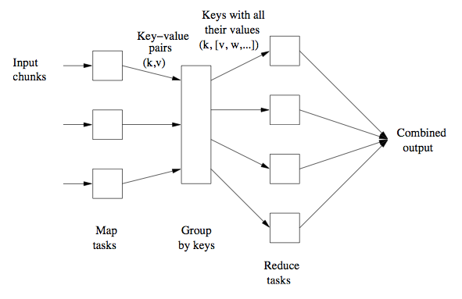
Map-Reduce: Summary
Map tasks
Input is in “key-value” format, e.g., key = file locations, value = text
Map code written by the user
Processes chunks and produces sequence of key-value pairs, Notice: the “key” is not in usual sense, do not have to be unique
Group by Key/Shuffle
Collects key-value pairs from each Map task
Values associated with each key are formed into a list of values
All key-value pairs with same key go to same Reduce task
Reduce task
Reduce code written by user
Produces output key-value pairs
Notes:
A Map task can produce several key-value pairs with same key

Slide 42
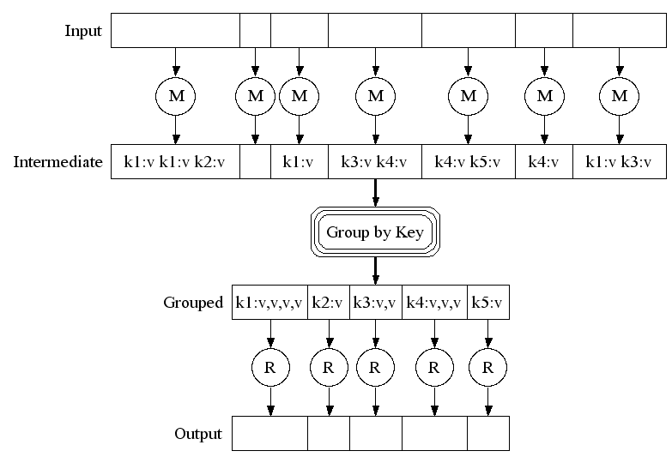
Map-Reduce: A Diagram
Big document
MAP:
Read input and produces a set of key-value pairs
Group by key:
Collect all pairs with same key
(Hash merge, Shuffle, Sort, Partition)
Reduce:
Collect all values belonging to the key and output

Slide 43
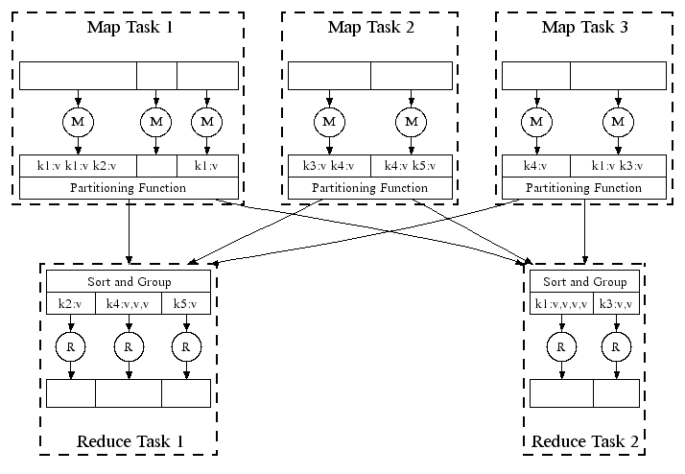
Map-Reduce: In Parallel
Hash function
All phases are distributed with many tasks doing the work
Notes:
Here is the architecture of how it actually works in a distributed file system.
And map and reduce tasks are running parallelly on different nodes.
Here are few chunks of file to be on node 1.
The hash function would tell the map reduce system which reduce node to send that key value pair to.
This ensures that all the pairs with the same key values. whether they are in map task 1, 2, 3. would end up being in the same reduce task.
Once the map tasks have completed, the reduce tasks first job is to sort its input and group it together by key.

Slide 44
Map-Reduce: Environment
MapReduce environment takes care of:
Partitioning the input data
Scheduling the program’s execution across a set of nodes
Performing the group by key step
Handling machine failures
Managing required inter-machine communication
Notes:
Remember that a programmer would need to write Map and Reduce program.
The Map-Reduce environment has to take care of a bunch of things. It takes care of partitioning the input data.
Scheduling the program’s execution across a set of nodes to figure out where the map tasks run where the reduce tasks run and so on.
The environment would make sure that the nodes are hidden from the program

Slide 45
Data Flow
Input and final output are stored on a distributed file system (DFS)
Scheduler tries to schedule map tasks “close” to physical storage location of input data
Intermediate results are stored on local file system of Map workers
e.g., output of the map step
Output is often input to another Map-Reduce task
Notes:
Let’s take a look at the data flow
It is reasonable to create one Map task for every chunk of the input file(s). Run on the same chunk server.
So there is actually no data copy or data moving associated with the map step.

Slide 46
Coordination: Master
Master node takes care of coordination:
Task status: idle, in-progress, completed
Idle tasks get scheduled as workers become available
When a map task completes, it sends the master the location and sizes of its R intermediate files, one for each reducer (R = number of reducers)
Master pushes this info to reducers
Master pings workers periodically to detect failures
Notes:
Master node takes care of all the coordination of a Map-reduce job. The master node keeps a task status with each task.
And each task has a status flag, the status flag can either be idle, in-progress or completed.
if there is a free node. The master would go through its queue of idle tasks and schedules an idle task on that.
There would be one intermediate file created for each of the reducer. So when a map task completes, it stores R intermediate file on its local file system, and let the master know what are those file location and sizes
Once the reducers knows that all the mappers are completed, then they copy the intermediate file from each of the map tasks

Slide 47
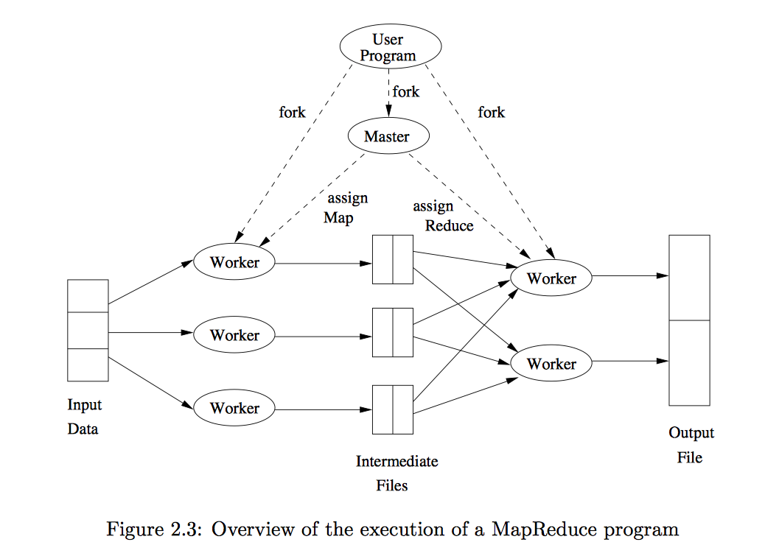

Slide 48
Dealing with Failures
Map worker failure
Map tasks completed or in-process at worker are reset to idle (why?)
Idle tasks eventually rescheduled on other worker(s)
Notes:
If a map worker fails, then all the map tasks that scheduled on that map worker may have failed.
The tricky thing is that the output of a map task is written to the local file system of the map worker.
So if a map worker fails, then all the intermediate output created by all the map tasks are lost.
And what master does, is that it resets all the completed or in-process tasks to be idle and reschedule those tasks.
If a reduce

Slide 49
Dealing with Failures
Map worker failure
Map tasks completed or in-process at worker are reset to idle (why?)
Idle tasks eventually rescheduled on other worker(s)
Reduce worker failure
Only in-process tasks are reset to idle
Idle Reduce tasks restarted on other worker(s)
Notes:
If a reduce worker fails, only the in-process tasks are set to idle. the tasks that have already completed don’t need to set to idle. Because the output pf the reduce worker is a final output and it’s written to the distributed file system and not to the local file system of the reduce worker. Since the output is written to the distributed file system. even the reduce worker fails, the output is not lost.

Slide 50
Dealing with Failures
Map worker failure
Map tasks completed or in-process at worker are reset to idle (why?)
Idle tasks eventually rescheduled on other worker(s)
Reduce worker failure
Only in-process tasks are reset to idle
Idle Reduce tasks restarted on other worker(s)
Master failure
Map-reduce task is aborted and client is notified
Notes:
And client can do something like restarting the mapreduce task.
The master is a single node, and therefore, the chance of the master can fail is actually quite uncommon
So the problem that you have with is if you have multiple workers running map and reduce tasks. It’s much more likely that one of many workers failed

Slide 51
How Many Map and Reduce Jobs?
M map tasks, R reduce tasks
Notes:
Suppose we have M map task and R reduce task, our goal is to determine what is the number for M and R
This is part of the input that given to the map reduce system to let it know how many tasks it needs to schedule.

Slide 52
How Many Map and Reduce Jobs?
M map tasks, R reduce tasks
Rule of a thumb:
Make M much larger than the number of nodes in the cluster
One DFS chunk per map task is common
Improves dynamic load balancing and speeds up recovery from worker failures
Notes:
That means on each node you will have many small map tasks on one node
and if that node fails, then those map tasks can then be spread across all the available nodes and so the entire tasks with complete much faster.

Slide 53
How Many Map and Reduce Jobs?
M map tasks, R reduce tasks
Rule of a thumb:
Make M much larger than the number of nodes in the cluster
One DFS chunk per map task is common
Improves dynamic load balancing and speeds up recovery from worker failures
Usually R is smaller than M
Output is spread across R files
Google example: Often use 200,000 map tasks, 5000 reduce tasks on 2000 machines
Notes:
It usually convenient to have the output spread across small number of nodes instead of large number of nodes

Slide 54
Refinement: Combiners
Combiner combines the values of all keys of a single mapper (single node)
Much less data needs to be copied and shuffled!
Works if reduce function is commutative and associative

Slide 55
Refinement: Partition Function
Control how keys get partitioned (which key goes where?)
Reduce needs to ensure that records with the same intermediate key end up at the same worker
System uses a default partition function:
hash(key) mod R
Sometimes useful to override the hash function:
E.g., hash(hostname(URL)) mod R ensures URLs from the same host to end up in the same output file
Notes:
Remember that we use a hash function in the intermediate key value pairs to decide which node each key value pair should go
Sometimes you want to override this function with a customer function.

Slide 56
Implementations
Google’s MapReduce
Not available outside Google
Hadoop
Open-source implementation in Java
Uses HDFS for stable storage
Download: http://hadoop.apache.org/releases.html
Spark (at your hand ☺ )

Slide 57
More Examples: Relational Join
Employee
Assigned Departments
Name | SSN
Sue | 999999999
Tony | 777777777
EmpSSN | DepName
999999999 | Accounts
777777777 | Sales
777777777 | Marketing
Emplyee ⨝ Assigned Departments
Name | SSN | EmpSSN | DepName
Sue | 999999999 | 999999999 | Accounts
Tony | 777777777 | 777777777 | Sales
Tony | 777777777 | 777777777 | Marketing

Slide 58
Example: Relational Join
Map Task: Emit (key, value) pair
Key = “the key used for the join”
Value is a tuple with all fields from table (including the table name)
Employee
Name | SSN
Sue | 999999999
Tony | 777777777
key=999999999, value=(Employee, Sue, 999999999) key=777777777, value=(Employee, Tony, 777777777)
Assigned Departments
EmpSSN | DepName
999999999 | Accounts
777777777 | Sales
777777777 | Marketing
key=999999999, value=(Department, 999999999, Accounts) key=777777777, value=(Department, 777777777, Sales) key=777777777, value=(Department, 777777777, Marketing)

Slide 59




Example: Relational Join
Group by Key: groups together all values (tuples) associated with each key
Reduce task: emit joined values (without table names)
key=999999999, values=[(Employee, Sue, 999999999),
(Department, 999999999, Accounts)]
Sue, 999999999, 999999999, Accounts
key=777777777, values=[(Employee, Tony, 777777777),
(Department, 777777777, Sales),
(Department, 777777777, Marketing)]
Tony, 777777777, 777777777, Sales
Tony, 777777777, 777777777, Marketing

Slide 60
More Example: Distributed Sort
Goal: Sort a very large list of (firstName, lastName) pairs by lastName followed by firstName
Map task:
Reduce task:

Slide 61
Example: Distributed Sort
Map task
Emit (lastName, firstName)
Group by keys:
Group together entries with the same last name
Divide into non-overlapping alphabetical ranges (sorting)
Keys are sorted in alphabetical order
Reduce task
Processes one key at a time
For each (lastName, list(firstName)), emit (lastName, firstName) in alphabetical order (sorting)
Merge output from all Reduce tasks (e.g., write)

Slide 62
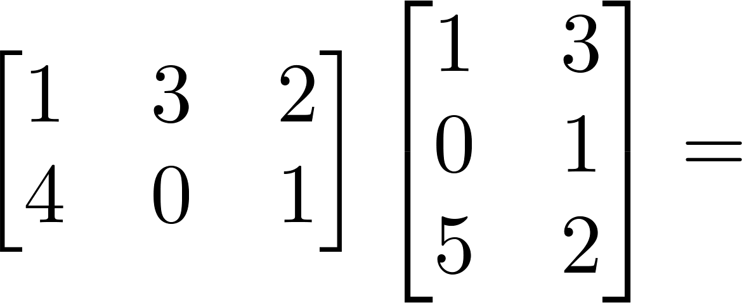

Example: Matrix Multiplication
Assume two matrices A and B, and AB = C
A_{ij} is the element in row i and column j of matrix A
Similarly for B and C
C_{ik} = ∑_{j} A_{ij} × B_{jk}
C_{ik} depends on the i^{th} row of A // that is A_{ij} for all j the k^{th} column of B // that is B_{jk} for all j
11
10
e.g., C₁₁ = 1×1 + 3×0
+ 2×5 = 11
9
14
A
B
C

Slide 63











Matrix Multiplication
Map-Reduce (One phase)
C = A X B
A has dimensions L x M
B has dimensions M x N
C has dimensions L x N
Matrix Multiplication: C[i, k] = SUM_{j} (A[i, j] x B[j, k])
Map task:
Reduce task:
X
=
A
B
C
Notes:
For each map, we might take a chunk of elements in the matrix
And our goal is to get the element in A and B that would contribute to a certain element in C, and then multiply each pair and then sum up value to get each element in result C

Slide 64
Matrix Multiplication
Map-Reduce (One phase)
C = A X B
A has dimensions L x M
B has dimensions M x N
C has dimensions L x N
Matrix Multiplication: C[i, k] = SUM_{j} (A[i, j] x B[j, k])
Map task:
for each element (i,j) of A, emit ((i,k), A[i,j]) for k in 1..N
(i,k) is the “place” in C where A[i,j] will be needed
for each element (j,k) of B, emit ((i,k), B[j,k]) for i in 1..L
(i,k) is the “place” in C where B[j,k] will be needed
X
=
A
B
C
Notes:
In order to let the program know which element in A should multiple to which element in B and contribute to which element in C
We use the location as the key, and the element value as the value.
Here the location is the element location in C. So for element (i,j) in A, emit (i, k) means this element is related to cik computation
Then the key value pairs with the same key would go to the same reduce node.
Therefore in the reduce step, it will know that elements with the same key should multiple together.

Slide 65
Matrix Multiplication
Map-Reduce (One phase)
C = A X B
A has dimensions L x M
B has dimensions M x N
C has dimensions L x N
Matrix Multiplication: C[i, k] = SUM_{j} (A[i, j] x B[j, k])
Map task:
for each element (i,j) of A, emit ((i,k), A[i,j]) for k in 1..N (i row)
e.g., For A[1, 1] emit ((1, 1), 1), ((1, 2), 1) // A₁₁=1 is needed for C₁₁, C₁₂
For A[1, 2] emit ((1, 1), 3), ((1, 2), 3) // A₁₂=3 is needed for C₁₁, C₁₂
For A[2, 1] emit ((2, 1), 4), ((2, 2), 4) // A₂₁=4 is needed for C₂₁, C₂₂
for each element (j,k) of B, emit ((i,k), B[j,k]) for i in 1..L (k column)
e.g., For B[1, 1] emit ((1, 1), 1), ((2, 1), 1) // B₁₁=1 is needed for C₁₁, C₂₁
For B[2, 1] emit ((1, 1), 0), ((2, 1), 0) // B₂₁=0 is needed for C₁₁, C₂₁
For B[1, 2] emit ((1, 2), 3), ((2, 2), 3) // B₁₂=3 is needed for C₁₂, C₂₂
11
10
9
14
A
B
C
C_{ik}
Notes:
However, this kind of key value par
When we ship them to reduce node, you lose the information about which matrix it comes from, also what is the original column or row.
you won’t know which pair times which pair

Slide 66
Matrix Multiplication
Map-Reduce (One phase)
C = A X B
A has dimensions L x M
B has dimensions M x N
C has dimensions L x N
Matrix Multiplication: C[i, k] = SUM_{j} (A[i, j] x B[j, k])
Map task:
for each element (i,j) of A, emit ((i,k), A[i,j]) for k in 1..N
Better: emit ((i,k), (‘A’, i, j, A[i,j])) for k in 1..N
Or just emit ((i,k), (‘A’, j, A[i,j])) for k in 1..N
for each element (j,k) of B, emit ((i,k), B[j,k]) for i in 1..L
Better: emit ((i,k), (‘B’, j, k, B[j,k])) for i in 1..L
Or just emit ((i,k), (‘B’, j, B[j,k])) for i in 1..L
X
=
A
B
C
C_{ik}
Notes:
So to improve it, in the value part, we not only have the element value, we also include the information about the matrix name and the original location of the element

Slide 67
Matrix Multiplication
Map-Reduce (One phase)
C = A X B
A has dimensions L x M
B has dimensions M x N
C has dimensions L x N
Matrix Multiplication: C[i, k] = SUM_{j} (A[i, j] x B[j, k])
Map task:
for each element (i,j) of A, emit ((i,k), (‘A’, i, j, A[i,j])) for k in 1..N
e.g., For A[1, 1] emit ((1, 1), (‘A’, 1, 1, 1)), ((1, 2), (‘A’, 1, 1, 1)) // for C₁₁, C₁₂
For A[1, 2] emit ((1, 1), (‘A’, 1, 2, 3)), ((1, 2), (‘A’, 1, 2, 3)) // for C₁₁, C₁₂
For A[2, 1] emit ((2, 1), (‘A’, 2, 1, 4)), ((2, 2), (‘A’, 2, 1, 4)) // for C₂₁, C₂₂
for each element (j,k) of B, emit ((i,k), (‘B’, j, k, B[j,k])) for i in 1..L
e.g., For B[1, 1] emit ((1, 1), (‘B’, 1, 1, 1)), ((2, 1), (‘B’, 1, 1, 1)) // for C₁₁, C₂₁
For B[2, 1] emit ((1, 1), (‘B’, 2, 1, 0)), ((2, 1), (‘B’, 2, 1, 0)) // for C₁₁, C₁₂
For B[1, 2] emit ((1, 2), (‘B’, 1, 2, 3)), ((2, 2), (‘B’, 1, 2, 3))
11
10
9
14
A
B
C
C_{ik}

Slide 68
X
=
C[i,k] = Sum_{j} (A[i,j] x B[j,k]), C is L x N
In the map phase:
for each element (i,j) of A, emit ((i,k), (‘A’, i, j, A[i,j])) for k in 1..N
for each element (j,k) of B, emit ((i,k), (‘B’, j, k, B[j,k])) for i in 1..L
e.g.,
C[1,1] = A[1,1] * B[1,1] + A[1,2] * B[2,1] + A[1,3] * B[3,1] + A[1,4] * B[4,1] + A[1,5] * B[5,1]
C[1,2] = A[1,1] * B[1,2] + A[1,2] * B[2,2] + A[1,3] * B[3,2] + A[1,4] * B[4,2] + A[1,5] * B[5,2]
C[2,1] = A[2,1] * B[1,1] + A[2,2] * B[2,1] + A[2,3] * B[3,1] + A[2,4] * B[4,1] + A[2,5] * B[5,1]
C[3,1] = A[3,1] * B[1,1] + A[3,2] * B[2,1] + A[3,3] * B[3,1] + A[3,4] * B[4,1] + A[3,5] * B[5,1]
Map phase: For A[1,2], emit ((1, k), (‘A’, 1, 2, A[1,2])) for k in 1..2
emit ((1,1)(‘A’, 1, 2, A[1,2])) ((1,2)(‘A’, 1, 2, A[1,2]))
For B[3,1], emit ((i, 1), (‘B’, 3, 1, B[3,1])) for i in 1..3
emit ((1,1), (‘B’, 3, 1,B[3,1])), ((2,1)(‘B’, 3, 1,B[3,1])), ((3,1)(‘B’, 3, 1,B[3,1]))
A
B
C
C_{ik}
Notes:
notice that if a reducer gets some of the elements in a row of A, but not all of them, then the elements of that row are useless;
the reducer cannot produce any output in that row. Similarly, if a reducer receives some but not all of a column of B, these inputs are also useless.
Thus, we may assume that the best mapping schema will send to each reducer some number of full rows of A and some number of full columns of B.
if and only if it has received the entire ith row of A and the entire kth column of B

Slide 69
Matrix Multiplication
Map-Reduce (One phase)
X
=
A simple exercise:
Suppose the data of matrices are distributed among 5 workers:
W1 has A-row-1, W2 has A-row-2, W3 has A-row-3
W4 has B-column-1, W5 has B-column-2
Now who sends out what?
For A[1, 1], W? emits ((1, 1), (‘A’, 1, 1, 1)), ((1, 2), (‘A’, 1, 1, 1))
For A[1, 2], W? emits ((1, 1), (‘A’, 1, 2, 3)), ((1, 2), (‘A’, 1, 2, 3))
For A[2, 1], W? emits ((2, 1), (‘A’, 2, 1, 4)), ((2, 2), (‘A’, 2, 1, 4))
For B[1, 1], W? emits ((1, 1), (‘B’, 1, 1, 1)), ((2, 1), (‘B’, 1, 1, 1))
For B[2, 1], W? emits ((1, 1), (‘B’, 2, 1, 0)), ((2, 1), (‘B’, 2, 1, 0))
For B[1, 2], W? emits ((1, 2), (‘B’, 1, 2, 3)), ((2, 2), (‘B’, 1, 2, 3))
A
B
C

Slide 70
Matrix Multiplication
Map-Reduce (One phase)
C = A X B
A has dimensions L x M
B has dimensions M x N
C has dimensions L x N
Matrix Multiplication: C[i, k] = SUM_{j} (A[i, j] x B[j, k])
Reduce task:
key = (i,k)
value = Sum_{j} (A[i,j] x B[j,k]) // this step does both Sum and Multiply
11
10
9
14
A
B
C
// We may break this step into more steps

Slide 71
Matrix Multiplication
Map-Reduce (Two Phases)
Main Ideas:
Phase 1: Multiply the appropriate values in 1st MapReduce phase
Phase 2: Sum up in 2nd MapReduce phase
Try this at home!

Slide 72
Matrix Multiplication
Map-Reduce (Two phase)
Idea: 1, Multiply the appropriate values in 1st MapReduce phase
2, Sum up in 2nd MapReduce phase
C[i,k] = Sum_{j} (A[i,j] x B[j,k]), C is L x N
e.g.,
C[1,1] = A[1,1] * B[1,1] + A[1,2] * B[2,1] + A[1,3] * B[3,1] + A[1,4] * B[4,1] + A[1,5] * B[5,1]
C[1,2] = A[1,1] * B[1,2] + A[1,2] * B[2,2] + A[1,3] * B[3,2] + A[1,4] * B[4,2] + A[1,5] * B[5,2]
1st Map Task:
For each matrix element A[i,j] : emit( j , (‘A’, i, A[i,j]))
For each matrix element B[j,k] : emit( j , (‘B’, k, B[j,k]))
e.g., (all will go to same reducer with key 2):
For A[1,2]: emit (2, (‘A’, 1, A[1,2]))
For B[2,1]: emit (2, (‘B’, 1, B[2,1]))
For B[2,2]: emit (2, (‘B’, 2, B[2,2]))

Slide 73
Matrix Multiplication
Map-Reduce (Two phase)
1st Reduce Task: (does the multiplication)
For each key j, produce all possible products
For each value of (i,k) which comes from A and B,
i.e., (‘A’, i, A[i, j]) and (‘B’, k, B[j, k]): emit ((i,k), (A[i, j] * B[j, k]))
e.g., (from map task)
For A[1,2]: emit (2, (‘A’, 1, A[1,2]))
For B[2,1]: emit (2, (‘B’, 1, B[2,1]))
For B[2,2]: emit (2, (‘B’, 2, B[2,2]))
Reduce task for key j: (j=2)
emit ((1,1), A[1,2] * B[2,1])
emit ((1,2), A[1,2] * B[2,2])
Notes:
We don’t need to care about if it would be a contribution for which location in C

Slide 74
Matrix Multiplication
Map-Reduce (Two phase)
2nd Map Task:
The input would be the (key, value) from 1st Reduce task
Let the pair of (( (i,k), (A[i, j] * B[j, k])) pass through
2nd Reduce Task: (does the summation)
For each (i,k), add up the values, emit ((i,k), SUM(values))
e.g., C[1,1] = A[1,1]*B[1,1] + A[1,2]*B[2,1] + A[1,3]*B[3,1] + A[1,4]*B[4,1] + A[1,5]*B[5,1]
(Note: every term has key (1,1), will go to same reducer)

Slide 75
General Characteristic of Good Problem for Map-Reduce
Data set is truly “big”
Terabytes, not tens of gigabytes
Hadoop/MapReduce designed for terabyte/petabyte scale computation
Most real-world problems process less than 100 GB of input
Microsoft, Yahoo: median job under 14 GB
Facebook: 90% of jobs under 100 GB
Source: “To Hadoop or Not to Hadoop” by Anand Krishnaswamy 8/13/2013

Slide 76
General Characteristic of Good Problem for Map-Reduce
Don’t need fast response time
When submitting jobs, Hadoop latency can be 1 min
Not well-suited for problems that require faster response time
online purchases, transaction processing
A good pre-computation engine
E.g., pre-compute related items for every item in inventory
Source: “To Hadoop or Not to Hadoop” by Anand Krishnaswamy 8/13/2013

Slide 77
General Characteristic of Good Problem for Map-Reduce
Good for applications that work in batch mode
Runs over entire data set
Takes time to initiate, run;
Shuffle step can be time-consuming;
Does not provide good support for random access to datasets
Extensions: Hive, Dremel, Shark, Amplab
Source: “To Hadoop or Not to Hadoop” by Anand Krishnaswamy 8/13/2013

Slide 78
General Characteristic of Good Problem for Map-Reduce
Best suited for data that can be expressed as key-value pairs without losing context, dependencies
Graph data is hard to process using Map-Reduce
Implicit relationships: edges, sub-trees, child/parent relationships, weights, etc.
Graph algorithms need information about the entire graph for each iteration
Hard to break into independent chunks for Map tasks
Alternatives: Google’s Pregel, Apache Giraph
Source: “To Hadoop or Not to Hadoop” by Anand Krishnaswamy 8/13/2013

Slide 79
General Characteristic of Good Problem for Map-Reduce
Other problems/data NOT suited for MapReduce
Tasks that need results of intermediate steps to compute results of current step
Interdependencies among tasks
Map tasks must be independent
Some machine learning algorithms
Gradient-based learning
Source: “To Hadoop or Not to Hadoop” by Anand Krishnaswamy 8/13/2013

Slide 80
General Characteristic of Good Problem for Map-Reduce
Summary: Good candidates for Map-Reduce:
Jobs that process huge quantities of data and either summarize or transform the content
Collected data has elements that can easily be captured with an identifier (key) and corresponding value
Source: “To Hadoop or Not to Hadoop” by Anand Krishnaswamy 8/13/2013

